Slide 1
Ubiquitous and Secure Networks and Services Redes y Servicios Ubicuos y Seguros
Unit 1: Introduction to Ubiquitous Services
Lourdes López Santidrián
llopez@diatel.upm.es, lourdes.lopez@upm.es

Slide 2
Ubiquitous/pervasive computing
UNIT 1: Introduction to Ubiquitous Systems

Slide 3
Ubiquitous Computing
Mark Weiser
(1952-99, Xerox PARC)
“Ubiquitous computing is the
method of enhancing computer
use by making many computers
available throughout the
physical environment, but
making them effectively
invisible to the user.”
[CoACM 1993]

Slide 4
Pervasive Computing
Definition
Pervasive computing is the trend towards increasingly ubiquitous
(another name for the movement is ubiquitous computing),
connected computing devices in the environment, a trend being
brought about by a convergence of advanced electronic – and
particularly, wireless - technologies and the Internet.
[SearchNet]
Pervasive computing devices are not personal computers , but very tiny - even invisible - devices, either mobile or embedded in almost any type of object imaginable, including cars, tools, appliances, clothing and various consumer goods - all communicating through increasingly interconnected networks.

Slide 5
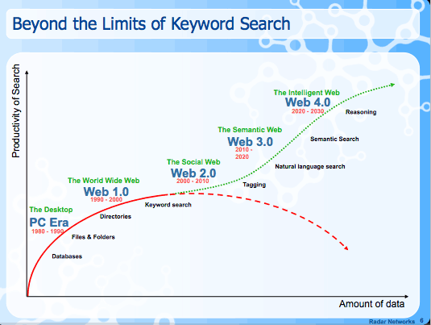
Internet Evolution
Nova Spivack. Making Sense of the Semantic Web.
http://www.slideshare.net/syawal/nova-spivack-semantic-web-talk.
Used under the Creative Commons License.
[Spivak]

Slide 6
Internet Generations
1st Generation Research Network | Early 1970 - 1995 | Networks for professionals (researchers and computer engineers). Defense (ARPANET) in the late 70s. Academia (CSNET/NSFNET) in the late 80s. Commercial
2nd Generation WWW & QoS | 1995 - 2005 | Information infrastructure for general people QoS control, Mobility, Multicast, Security, Terabit routers
3rd Gerneration QoL | 2005 - | Ultra-broadband Ubiquitous computing Robust and secure

Slide 7
Technology Issues of Current Internet
Technology | Description
Broadband | Photonic network, IP over WDM
High-performance Router | Tera-bit router
QoS Control | DiffServ, MPLS, Traffic engineering, Queue management
Multicast | QoS IP Multicast, Multicast using AP layer
Address-space Extension | IPv6 including security and QoS control
Mobility Control | Mobile IP + Service continuity/Media handover
Security | Encryption, AAA (Authentication, Authorization and Accounting), Security Protocols (IPSec, SSL, PKI, S-MIME)
Notes:
wavelength-division multiplexing (WDM) is a technology which multiplexes multiple optical carrier signals on a single optical fiber by using different wavelengths (colours) of laser light to carry different signals. This allows for a multiplication in capacity, in addition to enabling bidirectional communications over one strand of fiber.

Slide 8
Thechnology Issues of 3rd Generation Internet
Technology | Description
Ultra broadband | Petabit routers
Ubiquitous Computing | PAN (Personal Area Network) HAN (Home Area Network) Seamless connectivity Heterogeneous networks Terminals Adaptively-customized/personalized services Contest awareness
Robust and secure | Autonomous network management at fault occurrences Protection against cyber attacks
Notes:
Awareness = conciencia

Slide 9
Ubiquitous Sytems features
Computers extremely more ubiquitous than persons
Pervasive Computing
Not Aware of Computers
Calm, Invisible, Implicit, Proactive Computing
Sensing
Sentient, Perceptual, Ambient Computing
Mobility Support
Mobile, Nomadic Computing

Slide 10
Network aspects and deployment in us
UNIT 1: Introduction to Ubiquitous Systems

Slide 11
Ubiquitous Networks
Definition
Computing devices embedded in almost everything around us.
Platforms and networks which interconnect them.
User devices which make use of and act on the available information.
[JapanMPM]

Slide 12
Network technologies for Ubiquitous Systems
Wide-area cellular network.
Wireless LAN.
Home network.
Short range/ad hoc network (Bluetooth, IR, DSRC).
Wireless Sensor Network.

Slide 13
Terminal technologies for Ubiquitous Systems
Terminal
Note PC/PDA.
Cellular phone.
Home server and terminal/appliances.
Robot.
Weareable terminal with various sensores.
Car terminal.
Server-terminal middleware.

Slide 14
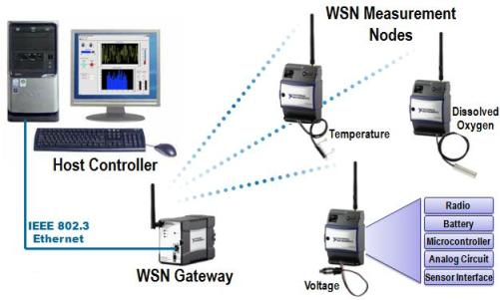
Wireless Sensor Network
National Instruments. Figure 2. Common Wireless Sensor Network Architecture.. “What is a Wireless Sensor Network? ”. http://zone.ni.com/devzone/cda/tut/p/id/8707.. Used by kind permission of National Instruments.
[Ni]

Slide 15
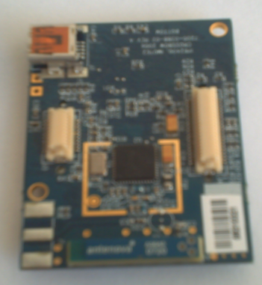
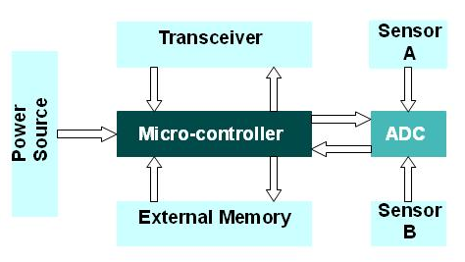
Motes
Notes:
Flash memories are used due to its cost and storage capacity.
Transceiver: Sensor nodes make use of ISM band which gives free radio, spectrum allocation and global availability. The various choices of wireless transmission media are Radio frequency, Optical communication (Laser) and Infrared.
Sensors are hardware devices that produce measurable response to a change in a physical condition like temperature and pressure. Sensors sense or measure physical data of the area to be monitored. The continual analog signal sensed by the sensors is digitized by an Analog-to-digital converter and sent to controllers for further processing.

Slide 16
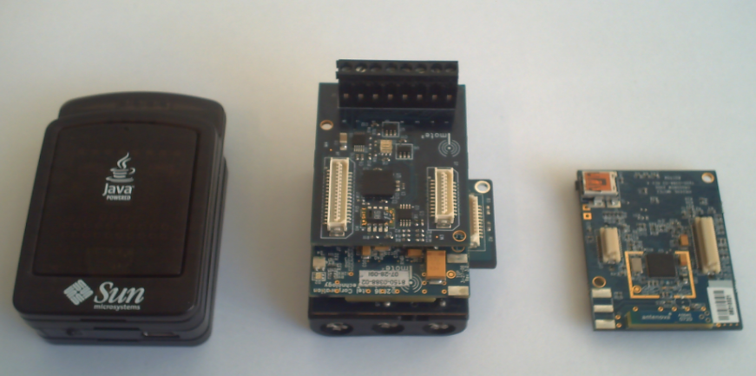
Types of motes

Slide 17
WSN Power and Network Standards
IEEE 802.15.4 LR-WPAN
Physical Access Control layer.
Medium Access Control layer.
Communication in the 868 to 915 MHZ and 2.4 GHz ISM bands.
Data rates up to 250 kb/s.
ZigBee
Builds on the 802.15.4.
Application Support layer.
Network/Security layer.

Slide 18
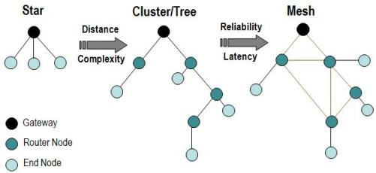
WSN Topologies
National Instruments. Figure 3. WSN Network Topologies.“What is a Wireless Sensor Network? ”. http://zone.ni.com/devzone/cda/tut/p/id/8707. Used by kind permission of National Instruments.
[Ni]
Notes:
Mesh = malla

Slide 19
Future internet
UNIT 1: Introduction to Ubiquitous Systems

Slide 20
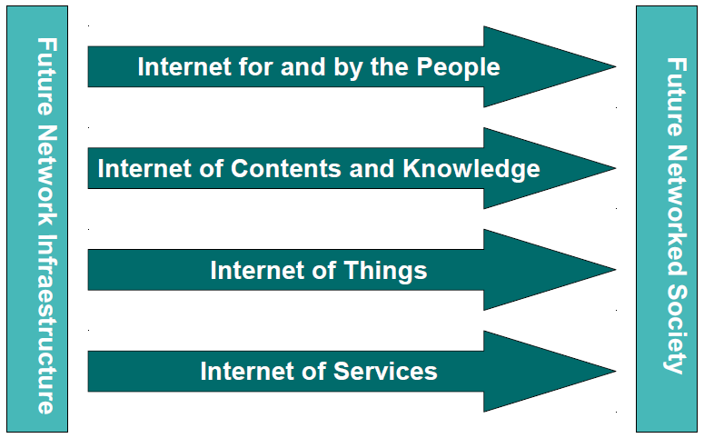
Future Internet
Notes:
The Future Internet will be at the heart of the future networked society. It will be the global
communications network: ubiquitous, accessible, scalable, sustainable, adaptable and highly
personalised. Rather than a simple evolution from the current internet, this Future Internet will arise
from the convergence of new network concepts embracing technologies, services, media and
content. It will offer flexibility and diversity, with scalable content and services accessible through a
wide range of interfaces and devices.
The Future Internet, it is now widely accepted, will have five pillars. As well as an Internet of
Networks, there will be an Internet of Services; an Internet of Things integrating common objects
into our lives; an Internet of Contents & Knowledge; and an Internet of People. Usability, reliability,
mobility, scalability, interoperability, user acceptability, and trust and confidence are just some of the
challenges facing Future Internet development. Non-technical aspects, such internet governance,
intellectual property, and education also need to be addressed.

Slide 21
Future Network Infrastructure
Based on an ubiquitous, high-capacity network.
The network will provide us with communication services in a way that will be both transparent and user-focused.
Its network infrastructures will provide mass services while adhering to security and privacy standards as well as with keeping context and personalization in mind for each case.
The network will allow the Internet of the Future by bridging the gap between the digital and non-digital worlds.

Slide 22
What is the Internet of People?
Definitions
(1) A hyper-connected society, in which the option to communicate with others will be not only permanent and universal, but also available through different kinds of media and by using numerous devices.
Telefónica
(2) Communication services will support one-to-one, one-to-many and many-to-many forms of communication, combining voice, text, images, video, telepresence, 3D video and even holograms, and allowing the above methods to complement one another.
Telefónica

Slide 23
What is the Internet of Contents and Knowledge?
Definition
The access by advanced search means and the interaction with multimedia content (for example, 3D and Virtual Reality). This can then be created and manipulated by professionals and non-professionals for distribution and sharing everywhere, on any terminal.
[AtosCon]

Slide 24
What is the Internet of Things?
Definitions
(1) The Internet of Things, also called The Internet of Objects, refers to a network among objects that will usually be wireless and self-configuring, such as household appliances.
[WikIoT]
(2) By embedding short-range mobile transceivers into a wide array of gadgets and everyday items, enabling new forms of communication between people and things, and among things themselves.
[WSIS 2005]
For more information: [Rdiego]

Slide 25
What is the Internet of Things?
Definitions
(3) The term "Internet of Things" has come to describe a number of technologies and research disciplines that enable the Internet to reach out into the real world of physical objects.
IoT 2008
(4) “Things having identities and virtual personalities operating in smart spaces using intelligent interfaces to connect and communicate within social, environmental, and user contexts”.
IoT in 2020
For more information: [Rdiego]

Slide 26
What is the Internet of Things?
History
1997, “The Internet of Things” is the seventh in the series of ITU Internet Reports originally launched in 1997 under the title “Challenges to the Network”.
1999, Auto-ID Center founded in MIT
2003, EPC Global founded in MIT
2005, Four important technologies of the internet of things was proposed in WSIS conference.
2008, First international conference of internet of things: The IOT 2008 was held at Zurich.

Slide 27
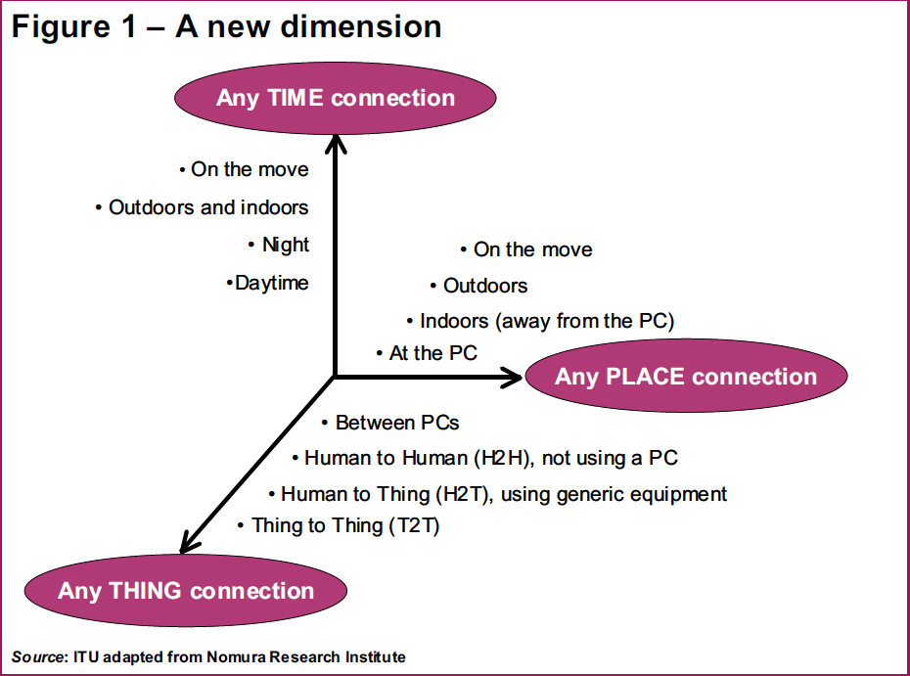
What is the Internet of Things?
“From any time, any place connectivity for anyone, we will now have connectivity for anything!”
International Telecommunication Union. Figure 1. A New Dimension. International Telecommunication Union. “ITU Internet Reports 2005: The Internet of Things. Executive Summary”. November, 2005. Used by kind permission of the International Telecommunications Union.
[ITU]
Notes:
An interesting conclusion

Slide 28
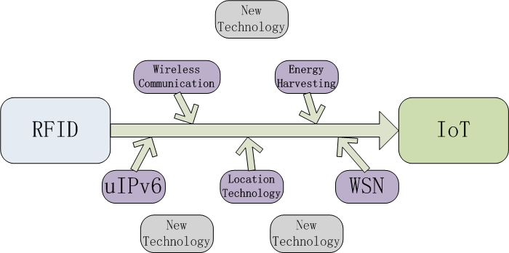
State of The Art of IoT
From RFID to IoT:
Notes:
Without the deployment of RFID, IoT may still not emerge. Internet of Things is not a future RFID only, but the IoT development is now depend on the development of RFID. It would be a long evolution by combining the technologies such as uIPv6, Wireless Communication, Location Technology, Energy Harvesting Technology, WSN and all other technologies that may appear on the way of IoT development together.
IoT is now on it’s starting point, it’s hard to view its state of the art from a practical technical way, but mostly in a predict way from these supporting technologies.

Slide 29
Why Internet of Things?
Dynamic control of industry and daily life
Improve the resource utilization ratio
Better relationship between human and nature
Forming an intellectual entity by integrating
human society and physical systems
Notes:
1 and 2 factors are about Resource Efficiency,
Energy conservation is a prerequisite for the Internet of Things. Therefore research producing new knowledge on how to develop more energy efficient electronics will influence the design of all electronics. Concept of energy harvesting will enable larger and larger portions of the consumed energy to be generated by ambient renewable sources available locally thus reducing the losses in long distance energy distribution.
Similar effects will be experienced by road transport and cars. Already today there are hybrid cars available harvesting the kinetic energy of the drive. This, in combination with better and more environmentally friendly energy storage in the future will make electrical vehicles achieve longer range and become more attractive alternatives.
Abundant sensory information will enable unprecedented energy optimised control. Climate control is the most energy consuming activity in modern buildings. The house could adjust the room temperatures according to the personal preferences of those in the room, and avoid heating or cooling rooms excessively without benefits to the inhabitants.
3. is the pollution and disaster avoidance

Slide 30
Why Internet of Things?
Flexible configuration
Universal transport & internetworking
Accessibility & Usability
Acts as technologies integrator
Notes:
1 and 2 factors are about Resource Efficiency,
Energy conservation is a prerequisite for the Internet of Things. Therefore research producing new knowledge on how to develop more energy efficient electronics will influence the design of all electronics. Concept of energy harvesting will enable larger and larger portions of the consumed energy to be generated by ambient renewable sources available locally thus reducing the losses in long distance energy distribution.
Similar effects will be experienced by road transport and cars. Already today there are hybrid cars available harvesting the kinetic energy of the drive. This, in combination with better and more environmentally friendly energy storage in the future will make electrical vehicles achieve longer range and become more attractive alternatives.
Abundant sensory information will enable unprecedented energy optimised control. Climate control is the most energy consuming activity in modern buildings. The house could adjust the room temperatures according to the personal preferences of those in the room, and avoid heating or cooling rooms excessively without benefits to the inhabitants.
3. is the pollution and disaster avoidance
4.

Slide 31
The Applications of IoT
Regional Office
Biosensor taken by people
House
Network
Equipment in public place
Transportation Vehicle
Virtual Environment
Notes:
Application area should be divided by that two

Slide 32
IoT: A Practical Example
Shopping
When entering a shop, scanners located in the doors will identify the tags on the customer’s clothing.
As the customer walks through the location, the goods will introduce themselves.
On placing goods in the cart the reader will tell the staff to place a new one in the shelve.
When payment for the items is due, the credit card’s microchip will communicate with checkout reader.

Slide 33
Enabling Technologies
RFID
Sensor
Smart Tech
Nano Tech
To identify and track the data of things .
To collect and process the data to detect the changes in the physical status of things
To enhance the power of the network by devolving processing capabilities to different part of the network.
To make the smaller and smaller things have the ability to connect and interact.
Notes:
More than four several technologies
machine-to-machine interfaces and protocols of electronic communication
microcontrollers
wireless communication
RFID
Energy harvesting technologies
sensor technology
Location technology
Software
IPv6

Slide 34
Sensor Technology
The ability to detect changes in the physical status of things is essential for recording changes in the environment.
Wireless sensor technology plays a pivotal role in bridging the gap between the physical and virtual worlds, and enabling things to respond to changes in their physical environment.
Sensors collect data from their environment, generating information and raising awareness about context.
Example: sensors in an electronic jacket can collect information about changes in external temperature and the parameters of the jacket can be adjusted accordingly.

Slide 35
What is the Internet of Services?
Definitions
(1) A new and elaborate vision for next-generation services provided via the Internet is known as the Internet of Services. The creation of these services is facilitated by an open platform and interface architecture, as provided by the Enterprise Service-Oriented Architecture (enterprise SOA).
[IoS]
(2) A service-oriented architecture (SOA) is essentially a collection of services. These services communicate with each other. The communication can involve either simple data passing or it could involve two or more services coordinating some activity. Some means of connecting services to each other is needed
[SerArc]

Slide 36
Bibliography
[AtosCon] http://lookout.atosconsulting.com/step-trends/technological/future-internet/
[CoACM 1993] Commun. ACM, July 1993.
[FutureInt 2008] http://www.future-internet.eu/home/future-internetassembly/madrid-dec-2008.html
[IoS] Internet of Services web page. http://www.internet-of-services.com
[IoT 2008] International Conference for Industry and Academia March 26-28, 2008 / Zurich. http://www.the-internet-of-things.org/iot2008/
[ITU] International Telecommunication Union. “ITU Internet Reports 2005: The Internet of Things. Executive Summary”. November, 2005.
[JapanMPM] Japan’s Ministry of Public Management, Home Affairs, Post and Telecommunications.
[Ni] National Instruments. http://zone.ni.com/devzone/cda/tut/p/id/8707.
[RDiego] http://rdiego.diatel.upm.es/r%26d/iot
[SearchNet] Definition obtained through http://ww.searchnetworking.com.
[SerArc] Service Architecture web page. http://www.service-architecture.com
[Spivack] Nova Spivack. Making Sense of the Semantic Web. http://www.slideshare.net/syawal/nova-spivack-semantic-web-talk
[WSIS 2005] World Summit on the Information Society. http://www.itu.int/wsis/tunis/index.html.

