Slide 1
Ubiquitous and Secure Networks and Services Redes y Servicios Ubicuos y Seguros
Unit 4: Network Technologies
Ana Belén García Hernando
abgarcia@diatel.upm.es, anabelen.garcia@upm.es

Slide 2
Networking challenges in WSN
Low energy consumption [vs. QoS].
Cross-layer optimization (interrelations, and co-designs, between different layers, e.g. link and routing protocols).
Low complexity and buffer space on the nodes.
Scalability.
Self-organization, self-healing, robustness, resilience.
Decentralized control (→ less efficient but more robust and scalable algorithms).
Data aggregation.
Possible absence of a global ID (new communication paradigms: data-centric, location-based, …).
Unequal traffic load (usually communication flows from many nodes to one or a few sinks: convergecast communication).

Slide 3
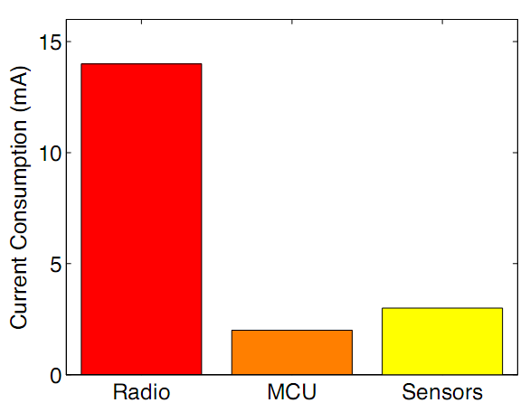
Energy consumption
Low energy consumption is usually the most stringent requisite.
The figure shows the energy consumption of typical node components in active mode (in sleep mode the consumption is negligible to this).
Low duty-cycle is a must for many applications in order to last enough time.
This may increase the delay (sleep delay), especially in multi-hop networks.
Energy consumption of typical node components. Measurements taken with a node using a CC2500 radio chip and MSP 430 MCU and typical accelerometers. [Plancoulaine2006] S. Plancoulaine, A. Bachir, and D. Barthel. “WSN Node Energy Dissipation”. France Telecom R&D, internal report. July 2006.

Slide 4
Protocol stack
[Upper layers]
End-2-end communication.
Topologies and routing are among its main characteristics, especially for multi-hop communication.
Data link
Communication between neighbouring nodes.
Medium Access Control (MAC) is the main design issue in WSN. It coordinates the usage of a medium that is shared by several nodes.
Physical
Interface to the (wireless) transmission medium.
Modulation, frequency bands, bit rate, …
Network
Transport layer (has received not much attention from the research community).
Applications.

Slide 5
Protocol stack
[Upper layers]
End-2-end communication.
Topologies and routing are among its main characteristics, especially for multi-hop communication.
Data link
Communication between neighbouring nodes.
Medium Access Control (MAC) is the main design issue in WSN. It coordinates the usage of a medium that is shared by several nodes.
Physical
Interface to the (wireless) transmission medium.
Modulation, frequency bands, bit rate, …
Network
Transport layer (has received not much attention from the research community).
Applications.

Slide 6
Medium Access Control
Reservation-based
There is a schedule for using the shared medium. E.g., TDMA.
The scheduling can be centralized or local-based (e.g. 2-hop schedules)
☺ May ensure fairness, avoids collisions
Contention-based
If several users try to transmit, there is a collision. Eventually a winner will succeed. E.g., CSMA.
☺ No need of global synchronization or topology knowledge. Simpler than reservation-based solutions.
☹ Requires knowing the topology and sometimes also synchronization. The establishment of the schedule produces overhead and may not escale well. Not very suitable for highly dynamic environments, either in topology or in traffic patterns.
☹ Possible collisions (→ higher energy consumption), performance drops when load increases.
Many protocols for WSN adopt a hybrid approach of some kind: preamble-sampling, hybrid schedule (contention / reserved), different mechanisms in different parts of the network, …

Slide 7
MAC: Main causes of energy consumption
Collisions:
Transmitting the collided frames and their reception is a waste of energy.
Overhearing:
Reception of irrelevant packets or signals.
Overhead:
Control packets and control information consumes energy.
Idle listening:
A radio not in sleep mode consumes a significant amount of energy.
Ideally, the radio should be on only when transmitting or receiving useful information.
This is not always achievable.

Slide 8
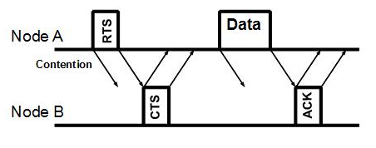
Example of MAC mechanism: CSMA/CA
Carrier sense multiple access with collision avoidance:
Contention-based, with an added mechanism to minimize collision occurrence.
RTS: Request To Send.
RTS is small → Low probability of collision.
CTS: Clear To Send.
Purpose: reserve the channel around the receiver. Nodes in the vicinity will refrain from transmitting.

Slide 9
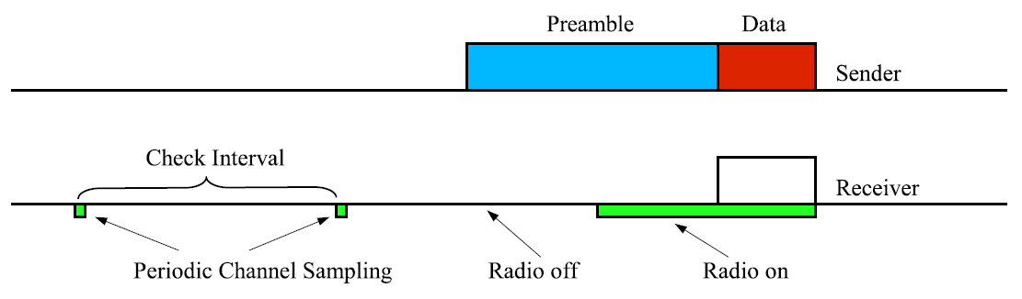
Example of MAC mechanism: preamble-sampling
Figure 9. Preamble sampling. [Bachir2010] Bachir, A.; Dohler, M.; Watteyne, T.; Leung, K.K. "MAC Essentials for Wireless Sensor Networks". IEEE Communications Surveys & Tutorials. Volume: 12, Issue: 2. 2010. Pp. 222 – 248.
Allows low-duty cycle, although there is a trade-off between:
Long check interval, which requires longer preamble.
Short preamble, which requires more frequent checking.
The pattern of the traffic determines the best check interval length.

Slide 10
Introduction to IEEE 802.15.4 Standard
“This standard defines the protocol and interconnection of devices via radio communication in a personal area network (PAN). The standard uses carrier sense multiple access with collision avoidance (CSMA-CA) medium access mechanism and supports star as well as peer-to-peer topologies. The media access is contention based; however, using the optional superframe structure, time slots can be allocated by the PAN coordinator to devices with time critical data. Connectivity to higher performance networks is provided through a PAN coordinator.” [802.15.4-2006]
Defines PHY and MAC layers.

Slide 11
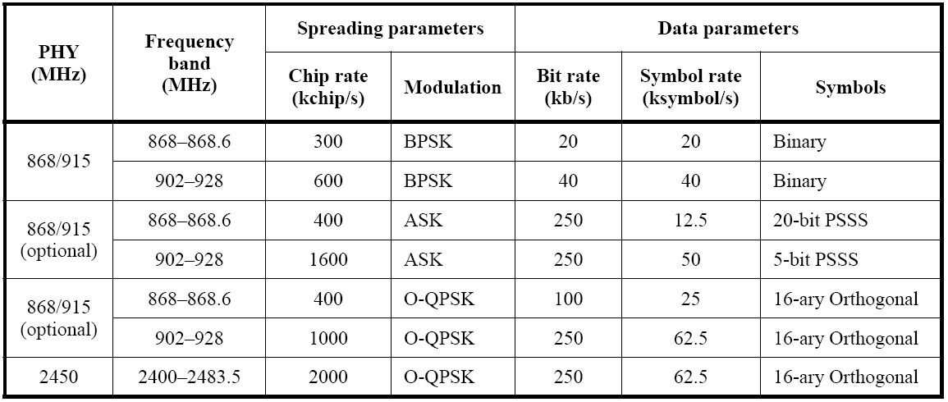
IEEE 802.15.4 PHY
Frequency bands and data rates included in the standard:
Table 1—Frequency bands and data rates, reprinted with permission from IEEE Std. 802.15.4-2006,Wireless Medium Access Control (MAC) and Physical Layer (PHY) Specifications for Low-Rate Wireless Personal Area Networks (WPANs), Copyright 2006, by IEEE. The IEEE disclaims any responsibility or liability resulting from the placement and use in the described manner.
From IEEE Std. IEEE Std. 802.15.4-2006,Wireless Medium Access Control (MAC) and Physical Layer (PHY) Specifications for Low-Rate Wireless Personal Area Networks (WPANs), Copyright 2006, by IEEE. All rights reserved.*

Slide 12
IEEE 802.15.4 MAC: types of devices
Two types of devices:
RFD (Reduced Function Devices).
Can only act as end-devices. Are equipped with sensors and/or actuators. May interact with a single FFD. Are usually simple devices.
FFD (Full Function Devices).
Can act as end-devices or as coordinators.
A FFD capable of relaying messages is a coordinator. One of these will be the PAN coordinator.
The PAN coordinator provides connectivity to higher-performance networks and is usually mains-powered.

Slide 13
IEEE 802.15.4 MAC: supported topologies
Peer-to-peer: any device may communicate with any other device as long as they are in range of one another.
This allows for the use of more complex topologies and multi-hop routing at higher layers.
Star: The rest of the nodes (RFDs or FFDs) only communicate with the PAN coordinator.
Figure 1—Star and peer-to-peer topology examples, reprinted with permission from IEEE Std. 802.15.4-2006,Wireless Medium Access Control (MAC) and Physical Layer (PHY) Specifications for Low-Rate Wireless Personal Area Networks (WPANs), Copyright 2006, by IEEE. The IEEE disclaims any responsibility or liability resulting from the placement and use in the described manner.
From IEEE Std. IEEE Std. 802.15.4-2006,Wireless Medium Access Control (MAC) and Physical Layer (PHY) Specifications for Low-Rate Wireless Personal Area Networks (WPANs), Copyright 2006,, by IEEE. All rights reserved.*

Slide 14
IEEE 802.15.4 MAC: PAN modes (I)
Beacon-enabled:
A coordinator transmits periodical beacons (with a period adjustable in the range 15ms to 245s) that define a superframe structure with an optional inactive portion.
Two parts in the active portion (hybrid MAC approach):
CSMA-CA
GTS (Guaranteed Time Slots)
The beacon also allows the devices to synchronize and indicates if there is any data waiting in the coordinator to reach a device (so that the device may ask for it).
Nonbeacon-enabled:
Unslotted CSMA-CA is used.
No GTS (Guaranteed Time Slots), no superframe structure.

Slide 15
IEEE 802.15.4 MAC: PAN modes (II)
Superframe structure (beacon-enabled mode):
CAP: Contention Access Period: Slotted CSMA-CA.
CFP: Contention Free Period:
Contains a variable number of GTS (Guaranteed Time Slots).
Assigned by the coordinator for low-latency applications or for applications requiring a minimum BW.
On a beacon-enabled PAN, a coordinator that is not the PAN coordinator shall maintain the timing of two superframes:
the superframe in which its coordinator transmits a beacon (the incoming superframe) and
the superframe in which it transmits its own beacon (the outgoing superframe).
Figure 66—An example of the super-frame structure, reprinted with permission from IEEE Std. 802.15.4-2006,Wireless Medium Access Control (MAC) and Physical Layer (PHY) Specifications for Low-Rate Wireless Personal Area Networks (WPANs), Copyright 2006, by IEEE. The IEEE disclaims any responsibility or liability resulting from the placement and use in the described manner.
From IEEE Std. IEEE Std. 802.15.4-2006,Wireless Medium Access Control (MAC) and Physical Layer (PHY) Specifications for Low-Rate Wireless Personal Area Networks (WPANs), Copyright 2006,, by IEEE. All rights reserved.*

Slide 16
Protocol stack
[Upper layers]
End-2-end communication.
Topologies and routing are among its main characteristics, especially for multi-hop communication.
Data link
Communication between neighbouring nodes.
Medium Access Control (MAC) is the main design issue in WSN. It coordinates the usage of a medium that is shared by several nodes.
Physical
Interface to the (wireless) transmission medium.
Modulation, frequency bands, bit rate, …
Network
Transport layer (has received not much attention from the research community).
Applications.

Slide 17
Routing in WSN: influencing factors
Network dynamics
Mobile nodes, channel / node failures, energy depletion.
Node deployment
Node density, controlled (deterministic) vs. random deployment
Energy considerations
Data delivery models and traffic patterns
Address-based vs. Data-centric approach
Node capabilities
Is there heterogeneity in the nodes?
Data aggregation/fusion
Topology
Flat, hierarchical, lineal

Slide 18

Data delivery models
Continuous
Event-driven
Query-driven
Hybrid: the case of your practical project.

Slide 19
Routing in WSN: types of routing protocols
Protocols “inherited” from conventional Ad-hoc wireless networks.
E.g. AODV (Ad hoc On Demand Distance Vector routing algorithm): the one used in ZigBee.
Simple topology-unaware routing mechanisms.
E.g. Flooding and gossiping.
Very simple, but energy inefficient or incurring in high delays.
Data-centric: the routing is made based on the data itself (using for instance attribute-based naming) instead of on global identifiers. Usually it includes some sort of data aggregation or in-network processing.
E.g. Directed Diffusion, SPIN.
For different classifications of routing protocols see [Karthickraja2010], [Lotf2010] or [Akkaya2005].

Slide 20
Routing in WSN: types of routing protocols (cont’d)
Hierarchical: combined with a cluster-based topology. May include data aggregation in cluster heads.
E.g. LEACH, in which cluster heads are selected dynamically.
Location-based: nodes know their location and the routing is based on the location of source and destination.
E.g. GEAR.
Network flow and QoS-aware.
E.g. MMSPEED.
Energy-aware routing protocols.

Slide 21
QoS-aware routing
Usual QoS metrics:
Reliability.
Timeliness.
Guarantees are usually statistical.
Some protocols are capable of giving differentiated guarantees to more than one traffic type.
Figure 3. Protocol structure of each node. Felemban, E.; Chang-Gun Lee; Ekici, E. "MMSPEED: multipath Multi-SPEED protocol for QoS guarantee of reliability and timeliness in wireless sensor networks". IEEE Transactions on Mobile Computing, Volume: 5, Issue: 6. 2006. Pp. 738 – 754.

Slide 22
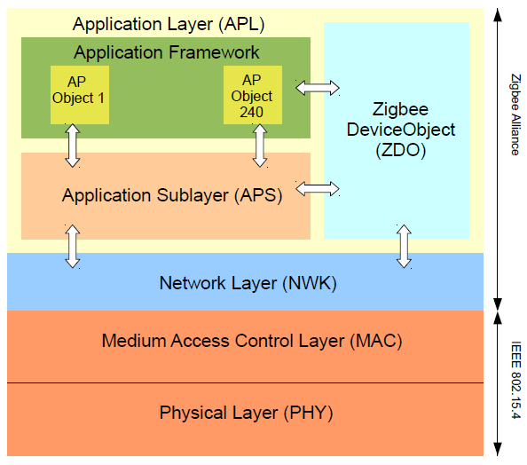
Introduction to ZigBee
From [ZigBee-2008]: “The ZigBee Alliance has developed a very low-cost, very low-power consumption, two-way, wireless communications standard.” “The IEEE 802.15.4-2003 standard defines the two lower layers: the physical (PHY) layer and the medium access control (MAC) sub-layer. The ZigBee Alliance builds on this foundation by providing the network (NWK) layer and the framework for the application layer.”

Slide 23
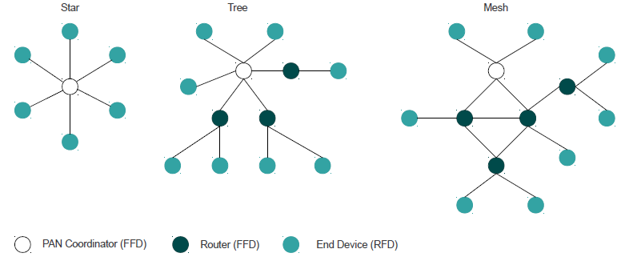
ZigBee: Network topologies
Tree networks: hierarchical routing strategy. Tree networks may employ beacon-oriented communication (IEEE 802.15.4). In this case “internal nodes coordinate their own star networks and, at the same time, act as a slave in their parent’s star network. Internal nodes must start their superframe suitably offset from their parent’s in order to avoid overlapping of their active portions.”
Mesh networks allow full peer-to-peer communication. Only nonbeacon-enabled communication is used.

Slide 24
ZigBee: Routing
ZigBee routing is based on AODV (Ad hoc On Demand Distance Vector routing algorithm).
AODV is an “on-demand” (or reactive) routing protocol because it creates (discovers) routes only when required by the source node.
For discovering routes to destinations it uses route requests (RREQ) and replies (RREP) messages that gather the accumulated cost of the possible routes.
Costs may be based on a link quality estimation provided by the IEEE 802.15.4 interface.

Slide 25
Why not IP for WSN?
The idea is having IP in every node instead of connecting WSN through specific gateways.
Towards a seamless integration with Internet.
There are still important challenges to tackle:
Addressing scheme.
IP-based routing does not fit well with data-centricity of some WSN applications.
Compatibility with layer 2.
6LoWPAN centers on transmitting IPv6 data over IEEE 802.15.4 frames.
Limited resources of nodes.
Some initial implementations were done consuming very few resources (e.g. uIP, lwIP).
Header size → Header compression.
Internet usual transport protocols are not tailored to WSN-specific characteristics
E.g. e2e retransmissions made by TCP. Some variants have been devised.
IPv4 or IPv6?
IPv6 includes mechanisms that may be useful in WSN (increased address space, stateless configuration mechanisms, …).

Slide 26
6LoWPAN
6LoWPAN Working Group (WG) from the Internet Engineering Task Force (IETF) [6LoWPAN].
Goal: define how to transmit IPv6 packets over low power wireless networks, with emphasis on the IEEE 802.15.4 standard.
Some important characteristics:
No need of configuration servers (no DHCP, no NAT).
Header compression to minimize header overhead.
Low footprint (initial implementations do not require more than a 32KB Flash ROM).
Some important WSN operating systems already include implementations of 6LoWPAN:
Contiki.
TinyOS.
Open issues: optimal dynamic IP routing protocol for WSN, plug&play capabilities, …).

Slide 27
Bibliography
[6LoWPAN] IETF 6LoWPAN Working Group. IPv6 over Low power WPAN. http://datatracker.ietf.org/wg/6lowpan/
[802.15.4-2006] IEEE Std 802.15.4™-2006: Wireless Medium Access Control (MAC) and Physical Layer (PHY) Specifications for Low-Rate Wireless Personal Area Networks (WPANs). September 2006.
[Akkaya2005] Kemal Akkaya, Mohamed F. Younis "A survey on routing protocols for wireless sensor networks". Ad Hoc Networks 3(3). Pp. 325-349. 2005.
[Bachir2010] Bachir, A.; Dohler, M.; Watteyne, T.; Leung, K.K. "MAC Essentials for Wireless Sensor Networks". IEEE Communications Surveys & Tutorials. Volume: 12, Issue: 2. 2010. Pp. 222 – 248.
[Baronti2007] Paolo Baronti, Prashant Pillai, Vince Chook, Stefano Chessa, Alberto Gotta, Y. Fun Hu. "Wireless Sensor Networks: a Survey on the State of the Art and the 802.15.4 and ZigBee Standards". Computer Communications, Vol 30, Issue 7. 2007.
[Correia2010] Paulo Alexandre Correia da Silva Neves, Joel José Puga Coelho Rodrigues. "Internet Protocol over Wireless Sensor Networks, from Myth to Reality". Journal of Communications, Volume 5, No. 3. 2010. Pp. 189-196.
[Felemban2006] Felemban, E.; Chang-Gun Lee; Ekici, E. "MMSPEED: multipath Multi-SPEED protocol for QoS guarantee of reliability and timeliness in wireless sensor networks". IEEE Transactions on Mobile Computing, Volume: 5, Issue: 6. 2006. Pp. 738 – 754.
[Karthickraja2010] Karthickraja, N.P.; Sumathy, V. "A study of routing protocols and a hybrid routing protocol based on Rapid Spanning Tree and Cluster Head Routing in Wireless Sensor Networks". International Conference on Wireless Communication and Sensor Computing, 2010 (ICWCSC 2010). Pp. 1 – 6.
[Kulik1999] Kulik, J.,Rabiner,W.,Balakrishnan, H. "Adaptive protocols for information dissemination in wireless sensor networks". Proceedings of Fifth ACM/IEEE Mobicom Conference, 1999. Pp.174-185.
[Lotf2010] Lotf, J.J.; Ghazani, S.H.H.N. "Overview on routing protocols in wireless sensor networks". 2nd International Conference on Computer Engineering and Technology (ICCET), 2010. Volume: 3. Pp. V3-610 - V3-614.
[Plancoulaine2006] S. Plancoulaine, A. Bachir, and D. Barthel. “WSN Node Energy Dissipation”. France Telecom R&D, internal report. July 2006.
[ZigBee-2008] ZigBee Alliance. ZigBee Specification. January 2008.

