Slide 1
Ubiquitous and Secure Networks and Services Redes y Servicios Ubicuos y Seguros
Unit 6: SunSpot Development Platform
Pedro Castillejo Parrilla
pcastillejo@diatel.upm.es

Slide 2
Sunspot technical specifications
UNIT 6: SunSpot Development Platform

Slide 3
SunSpot
Sun
Small Programmable Object Technology

Slide 4
SunSpot Hardware
Hardware
Small size package
Modular architecture
Stackable boards
Up to 3 floors
Power
Li-Ion Battery (nodes)
USB power (gateway/sink)

Slide 5
SunSpot Hardware
Processor
ARM 920T CPU (180MHz 32-bit)
Memory
512Kb RAM, 4Mb FLASH
Network
Chipcon 2420 radio with integrated antenna
IEEE 802.15.4 @ 2.4GHz
Data
USB interface— mini-b connector
Power supply
3.6V rechargeable 750 mAh Li-Ion battery
Normal power consumption: 40-100mA
Deep sleep mode consumption: 36 μA

Slide 6
SunSpot Hardware
eDemo Sensor Board
2G/6G 3-axis accelerometer
Light and temperature sensors
8 RGB LEDs
6 analog inputs (0-3Volts)
2 switches
5 general purpose I/O pins
4 high current output pins

Slide 7
SunSpot Hardware
External Interfaces
Digital Lines
4x Input/Output
Analog
10 bit ADC
6 input lines
Range: 0-3 Volts

Slide 8
SunSpot Hardware
Add-ons
Gyroscope (1x for 2D and 2x for 3D resolutions)
Data Glove (gaming, Virtual-Reality, …)
Game-Pad
Compass
Servo motors/controllers
Voice Synth.

Slide 9
SunSpot Software
Squawk VM
No underlying OS
Base code written in Java
Interpreter and low level I/O code written in C
Application development in a Java ME (CLDC 1.1) environment
Libraries to manage basic elements (sensors, leds, switches, …) already codified

Slide 10
SunSpot Software
Isolates
Single node-Single VM multiple apps running allowed
Isolated from each other
Asynchronous
No system down if one app crash
Ideal for security applications: several isolates for individual application needs (secured or unsecured).

Slide 11
SunSpot Software
Sun SPOT SDK Libraries
Both SunSpot nodes and desktop apps run over Squawk Java VM
Several Libraries already implemented
Java ME CLDC 1.1 libraries
Desktop libraries (Basestation, Host Apps)
Hardware management
Demo sensor board library
Radio and network libraries

Slide 12
SunSpot Software
Versions
v1.0 (Green)
v2.0 (Orange)
v3.0 (Purple)
v4.0 (Blue)
v5.0 (Red)
V6.0 (Yellow)

Slide 13
Introduction to SunSpot networks
UNIT 6: SunSpot Development Platform

Slide 14
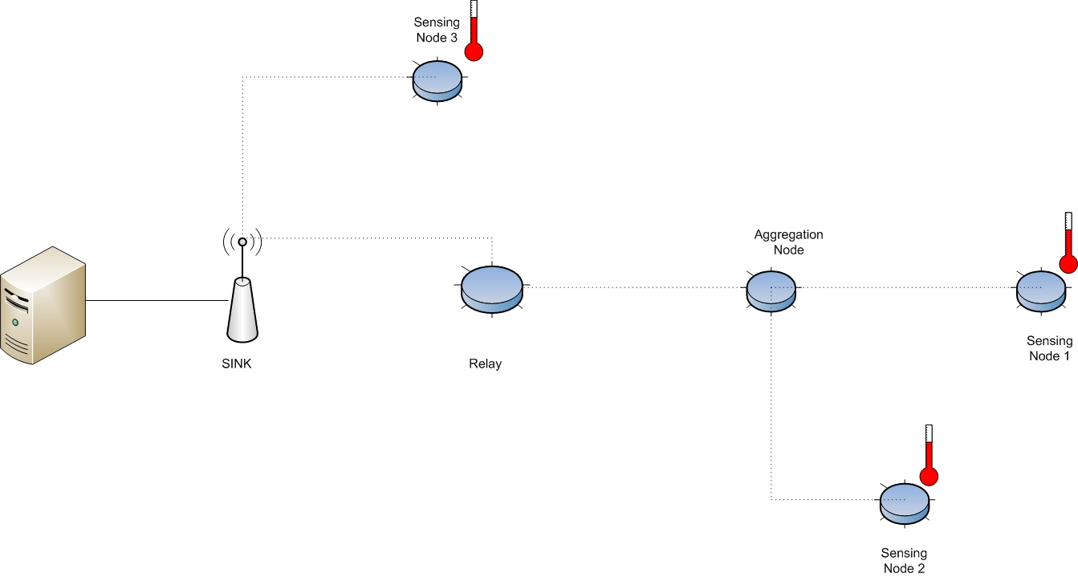
Network Topologies

Slide 15
Routing
Link Quality Routing Protocol (LQRP) algorithm is used by default to determine the best route, sending RREQs when necessary:
RREQ: requests for a route to a particular target SPOT that are broadcast by a requester, and then re-broadcast by each Sun SPOT that receives them. Each Sun SPOT that knows how to route to the requested target sends a reply back to the requester. The route that will be used is the one with the best link.
Routing Policies available:
ALWAYS: node will respond to and route RREQ and pass packets for other nodes. In order to guarantee that node will be always available for routing, deep sleep is disabled
IFAWAKE: similar to ALWAYS, but deep sleep is not specifically handled, so if a deep sleep is performed by the applications, the node may stop participating in the routing algorithm
ENDNODE: the node will not repeat RREQs to others or process packets for other nodes unless it is either the ultimate sender or destination
Ad-hoc On-Demand Distance Vector (AODV) algorithm can also be used, instead of LQRP.

Slide 16
Addressing
Every node is identified by its unique MAC Address
IEEE 802.15.4 MAC layer is used, with 64 bits addresses
Binding→ address:port Example: 0012.2CB4.A331.1DE9:77
Ports management:
0-31 reserved
32-255 available
Each node can manage several connections on the same port, to different destinations
IPv6 addressing is also implemented

Slide 17
Radio Protocols
Two protocols available, implemented on top of the 802.15.4 MAC layer
Radiostream protocol
Stream-based communication
Reliable and buffered
Radiogram protocol
Datagram-based communication
Sequence of packages and delivery and not repetition guarantee is NOT provided
Examples:
RadiostreamConnection conn=(RadiostreamConnection)Connector.open("radiostream://<destAddr>:<portNo>”)
RadiogramConnection conn=(RadiogramConnection)Connector.open("radiogram://<destAddr>:<portNo>”)

Slide 18
Radio Protocols
Radiostream Example
Node A
RadiostreamConnection conn =
(RadiostreamConnection)Connector.open("radiostream://0014.4F01.0000.0006:100");
DataInputStream dis = conn.openDataInputStream();
DataOutputStream dos = conn.openDataOutputStream();
try {
dos.writeUTF("Hello up there");
dos.flush();
System.out.println ("Answer was: " + dis.readUTF());
} catch (NoRouteException e) {
System.out.println ("No route to 0014.4F01.0000.0006");
} finally {
dis.close();
dos.close();
conn.close();
}

Slide 19
Radio Protocols
Radiostream Example
Node B
RadiostreamConnection conn =
(RadiostreamConnection)Connector.open("radiostream://0014.4F01.0000.0007:100");
DataInputStream dis = conn.openDataInputStream();
DataOutputStream dos = conn.openDataOutputStream();
try {
String question = dis.readUTF();
if (question.equals("Hello up there")) {
dos.writeUTF("Hello down there");
} else {
dos.writeUTF("What???");
}
dos.flush();
} catch (NoRouteException e) {
System.out.println ("No route to 0014.4F01.0000.0007");
} finally {
dis.close();
dos.close();
conn.close();
}

Slide 20
Radio Protocols
Radiostream Example (Server End)
RadiogramConnection conn = (RadiogramConnection)Connector.open("radiogram://:100");
Datagram dg = conn.newDatagram(conn.getMaximumLength());
Datagram dgreply = conn.newDatagram(conn.getMaximumLength());
try {
conn.receive(dg);
String question = dg.readUTF();
dgreply.reset(); // reset stream pointer
dgreply.setAddress(dg); // copy reply address from input
if (question.equals("Hello up there")) {
dgreply.writeUTF("Hello down there");
} else {
dgreply.writeUTF("What???");}
conn.send(dgreply);
} catch (NoRouteException e) {
System.out.println ("No route to " + dgreply.getAddress());
} finally {
conn.close();
}

Slide 21
Radio Protocols
Radiostream Example (Client End)
RadiogramConnection conn =
(RadiogramConnection)Connector.open("radiogram://0014.4F01.0000.0006:100");
Datagram dg = conn.newDatagram(conn.getMaximumLength());
try {
dg.writeUTF("Hello up there");
conn.send(dg);
conn.receive(dg);
System.out.println ("Received: " + dg.readUTF());
} catch (NoRouteException e) {
System.out.println ("No route to 0014.4F01.0000.0006");
} finally {
conn.close();
}

Slide 22
Broadcasting
Broadcasting is allowed, with some restrictions:
By default, broadcasts are transmitted over two hops (inside the PAN).
Can be changed to n hops using ((RadiogramConnection)conn).setMaxBroadcastHops(n);
Broadcast is not inter-PAN.
Broadcasted datagrams might not be delivered.
Broadcast connections cannot be used to receive. Open a server connection for receiving replies to a broadcast.
Opening a broadcasting radiogram connection:
DatagramConnection conn = (DatagramConnection)Connector.open("radiogram://broadcast:<portnum>");

Slide 23
Signal Strength Measures
At the reception side of a datagram, using RADIOGRAM connections, several measures regarding radio signal quality can be obtained.
RSSI (received signal strength indicator) measures the strength of the signal for the packet received, in a range between +60 (strong) to -60 (weak). Use getRssi() method.
CORR measures the average correlation value of the first 4 bytes of the packet header, in a range between 110 (maximum quality packet) to 50 (lowest quality packet). Use getCorr() method.
Link Quality Indication (LQI) is a characterization of the quality of a received packet, calculated using the correlation value. The LQI ranges from 0 (bad) to 255 (good). Use getLinkQuality() method.
Radio signal measures can be used to a wide variety of applications: localization, tracking, monitoring, …

Slide 24
HTTP Protocol Support
Any SPOT can open a http connection to any remote host or web service (via an Internet connected host computer), using the implemented http protocol stack.
Opening connections:
HttpConnection connection =(HttpConnection)Connector.open("http://host:[port]/filepath");
HTTP example:
HttpConnection connection = (HttpConnection)Connector.open("http://www.sunspotworld.com/");
connection.setRequestProperty("Connection", "close");
InputStream in = connection.openInputStream();
StringBuffer buf = new StringBuffer();
int ch;
while ((ch = in.read()) > 0) {
buf.append((char)ch);
}
System.out.println(buf.toString());
in.close();
connection.close();
SunSpot Programmer´s manual. http://www.sunspotworld.com/docs/Yellow/SunSPOT-Programmers-Manual.pdf

Slide 25
References
[Spw] www.sunspotworld.com
[Squawk] www.squawk.dev.java.net
[Sapiy] SunSpot API, Yellow Version available at:
www.sunspotworld.com/docs/Yellow/javadoc/index.html
[Susp] SunSpot Programmer´s manual:
http://www.sunspotworld.com/docs/Yellow/SunSPOT-Programmers-Manual.pdf
[Sapi] SunSpot API available at:
www.sunspotworld.com/docs/

